Slide 1


Principles of Programming Languages
(CS F301)
Jabez Christopher
Assistant Professor
Department of CSIS

Slide 2
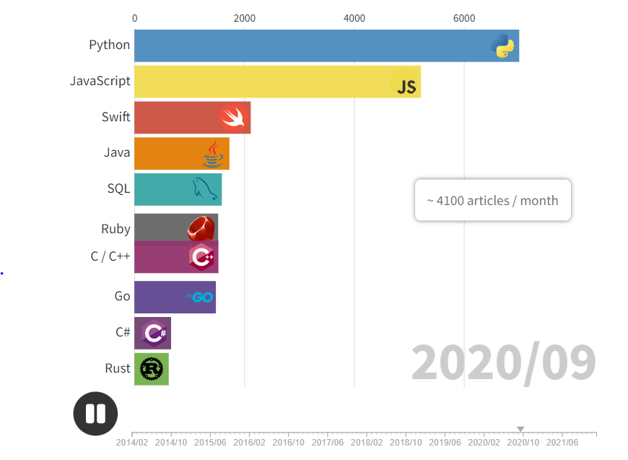
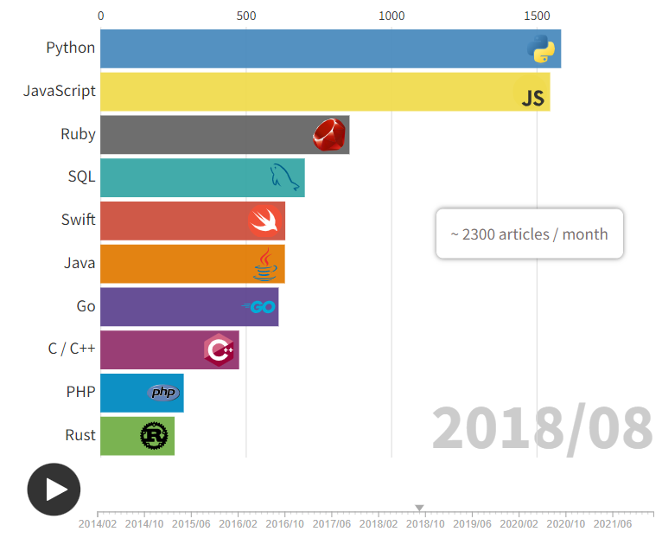
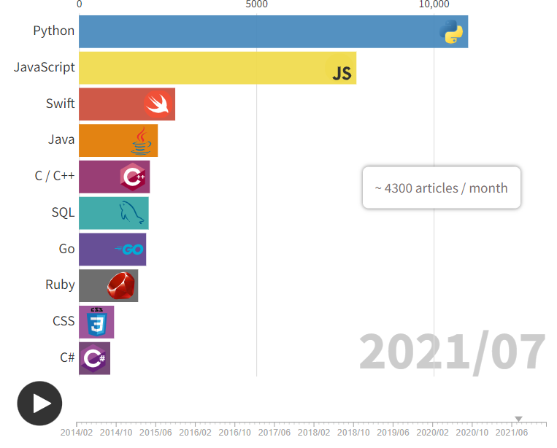
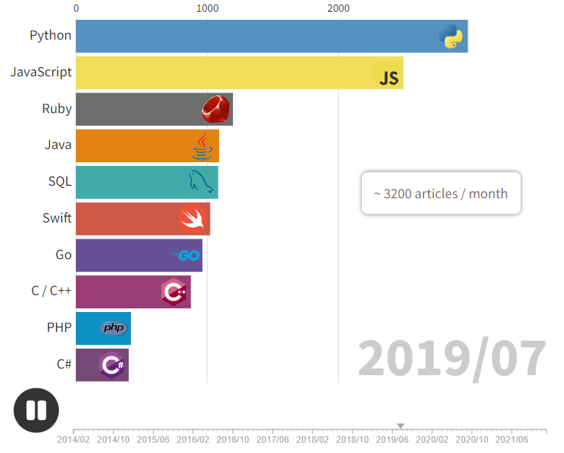

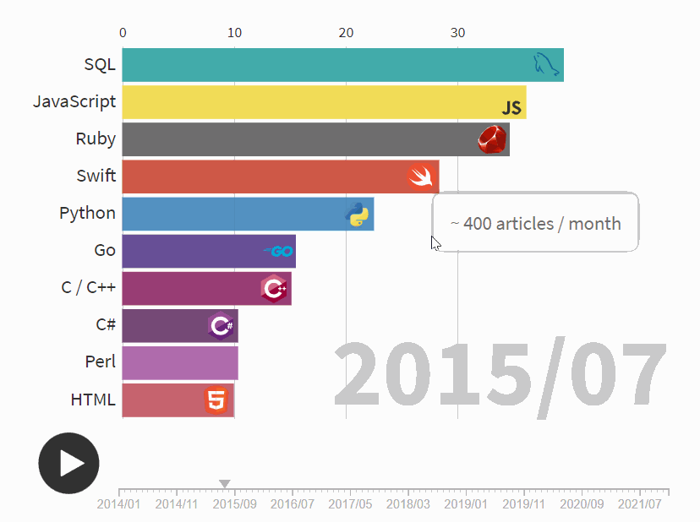
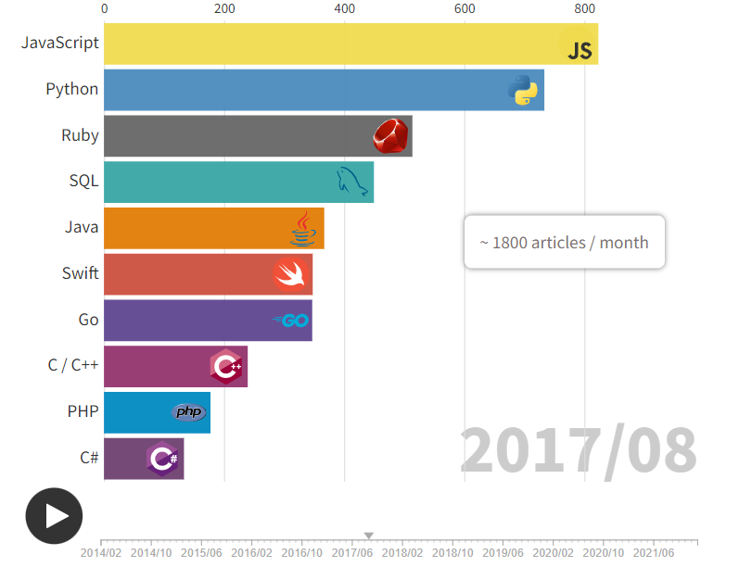
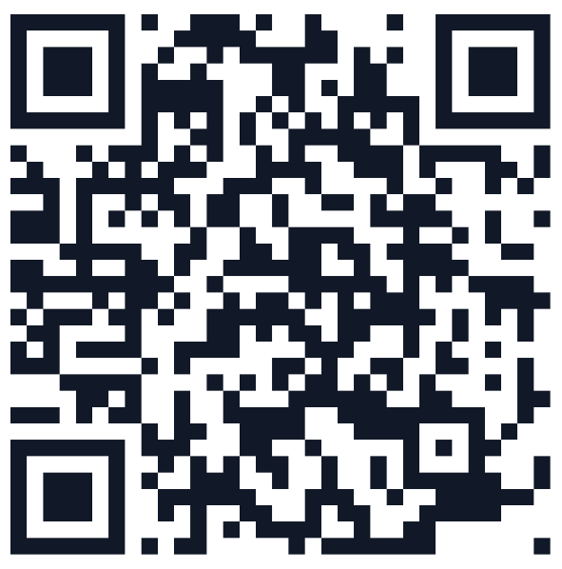
Evolution of programming languages
READING ASSIGNMENT
Included in QUIZ 1
https://www.youtube.com/watch?v=D_XdoKI4Vzg

Slide 3
Evolution of programming languages
The Importance Of Being Earnest
READING ASSIGNMENT
Included in QUIZ 1
The TIOBE Programming Community index is an indicator of the popularity of programming languages.
Calculated from the number of search engine results for queries containing the name of the language
The language should have an own entry on Wikipedia and Wikipedia should clearly state that it concerns a programming language
The programming language should be Turing complete.
The programming language should have at least 5,000 hits for +"<language> programming" for Google.
https://www.tiobe.com/tiobe-index/programminglanguages_definition/
https://www.youtube.com/watch?v=D_XdoKI4Vzg

Slide 4
Formal Methods of Describing Syntax
Regular Expression
BNF
EBNF
Attribute grammar (Syntax & Semantics)

Slide 5
Regular Expressions
• The lexemes of a programming languages are described formally by the use of regular expressions, where there are 3 operations, concatentation, repetition and selection:
— alb denotes a or b.
— ab denotes a followed by b
— (ab)* denotes a followed by b zero or more times
— (alb)c denotes a or b followed by c
• There are other operators that we can add to regular expression notations that make them easier to write:
[a-z] any character from a through z
r+ one or more occurrences of r
? An optional term
. Any one character
• Examples
[0-9]+ describes an integer
[0-9]+(\. [0-9]+)? describes an unsigned real

Slide 6
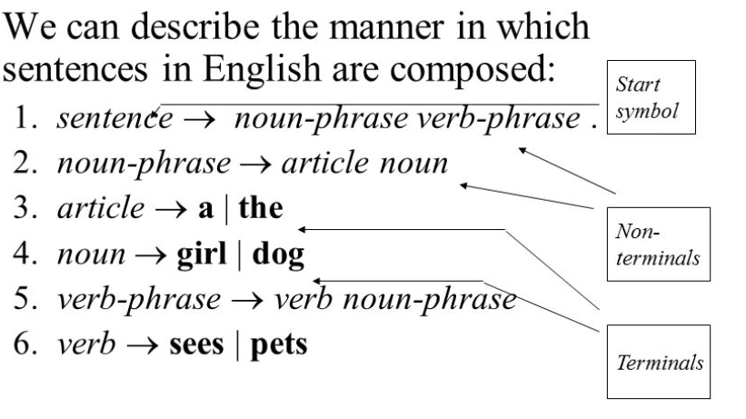
Grammar
The grammar of a language is expressed formally as
G = (T, N, S, P) where
T is a set of terminals (the basic, atomic symbols of a language).
N is a set of nonterminals (symbols which denote particular arrangements of terminals).
S is the start symbol (a special nonterminal which denotes the program as a whole).
P is the set of productions (rules showing how terminals and nonterminal can be arranged to form other nonterminals).

Slide 7
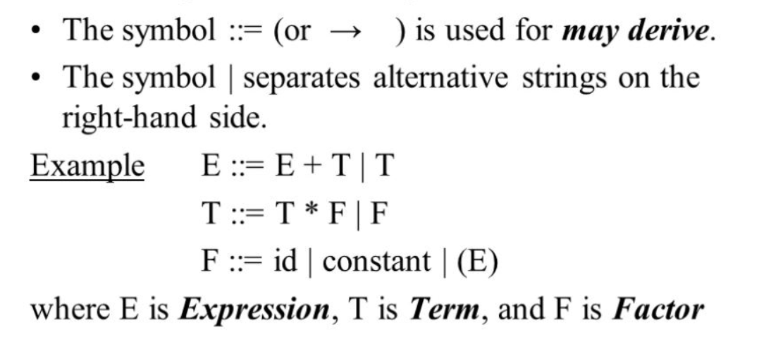
Context-Free Grammars and BNFs
• Context-Free grammars are grammars where non-terminals (collections of tokens in a language) always are deconstructed the same way, regardless of the context in which they are used.
• BNF (Backus-Naur form) is the standard notation or metalanguage used to specify the grammar of the language. It is a metalanguage for describing a context-free grammar.

